Slide 1
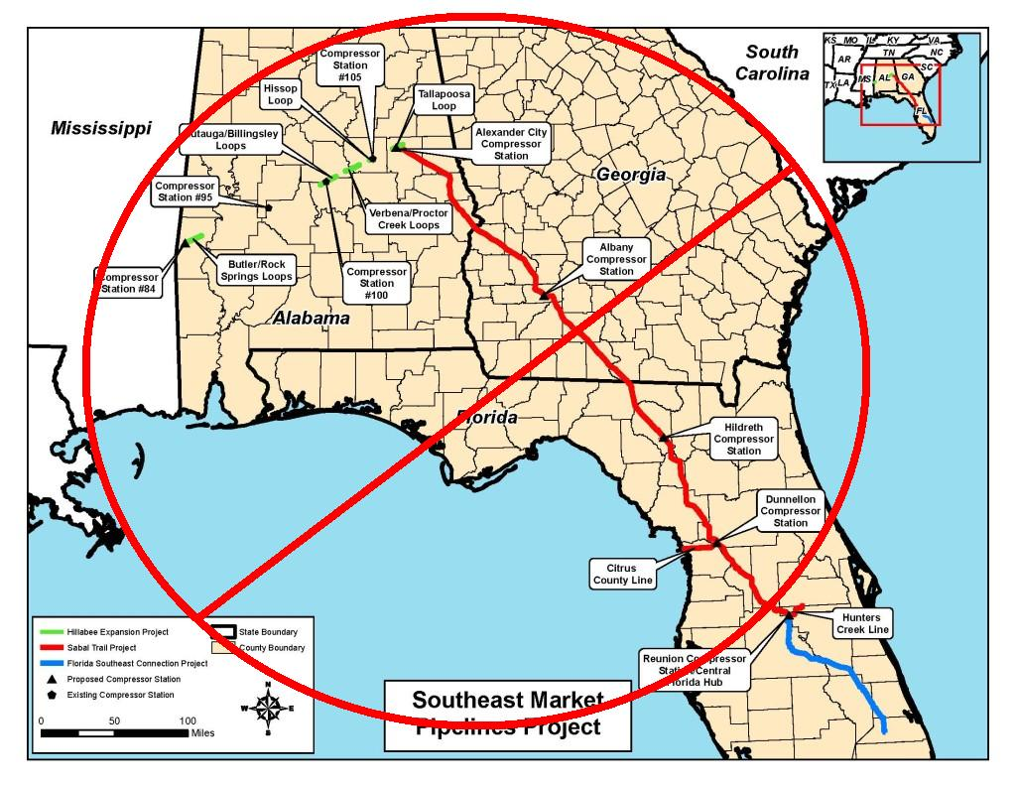
Sabal Trail Pipeline

Slide 2
A Hazardous Sabal Trail to LNG Export
AL-GA-FL Sierra Club Statement:
Water more important: do Solar power instead
100-foot RoW, 36-inch pipe, AL-GA-FL + Transco & FSC
Hazards: Spectra, Williams, etc. corrosion, leaks, explosions
Georgia Water Coalition Dirty Dozen,
#9: Sabal Trail threatens rivers and Floridan Aquifer
FPL's “need” for FL power & eminent domain
Conservation, efficiency, solar: faster, cheaper, and far cleaner
LNG export of fracked methane for 5 times domestic price
And those 3 already-authorized LNG export operations
What can be done

Slide 3
AL-GA-FL Sierra Club Statement against Sabal Trail 2014-03-04
“The Georgia, Florida, and Alabama Chapters of the Sierra Club oppose the 650 mile Sabal Trail Transmission natural gas pipeline that would carry fracked natural gas extracted from Pennsylvania and Texas through Alabama, Georgia, and Florida....
The proposed pipeline would cut a wide swath through pristine lands with resulting negative impacts on endangered species, critical wildlife habitat, invaluable wetlands, longleaf pine forests, the fragile and irreplaceable Floridian Aquifer, streams, rivers, and springs, and private property rights. Furthermore, expanded reliance on fracked natural gas only serves to feed the increasingly destructive effects of drilling for and fracking of shale deposits that have destroyed drinking water resources and entire communities across the country.
The Sunshine State, which will be the sole recipient of the fracked natural gas transported through this pipeline, should expand energy efficiency measures and solar power capacity rather than increase its dependence on natural gas which already accounts for more than 60% of Florida’s electricity generation.”
http://spectrabusters.org/2014/03/04/sierra-club-chapters-oppose-sabal-trail-gas-pipeline/

Slide 4
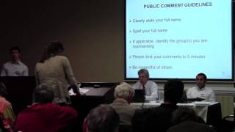
AL-GA-FL Sierra Club Statement read to FERC by Danielle Jordan

Slide 5
Author affiliations
John S. Quarterman
Member, Sierra Club, Georgia Chapter,
not speaking on behalf of Sierra Club
President, WWALS Watershed Coalition, Inc.,
Conserving the Withlacoochee, Willacoochee, Alapaha, and Little River systems in south Georgia and north Florida
Www.wwals.net, wwalswatershed@gmail.com
Board member, SpectraBusters, Inc., a Georgia nonprofit, landowners and others, with board members from AL,GA,FL:
“We ain't afraid a no pipeline”
SpectraBusters.org, spectrabusters@gmail.com

Slide 6
Southeast Market Pipeline Project
AL: Hillabee Expansion Project of Transco by Williams Co.
AL-GA-FL: Sabal Trail Transmission joint venture by Spectra Energy of Houston, TX and NextEra Energy of Juno Beach, FL, parent of FPL
FL: Florida Southeast Connection (FSC) by FPL
Same Environmental Assessment for all 3
Same contractor for EA: FERC won't release RFP or proposals

Slide 7
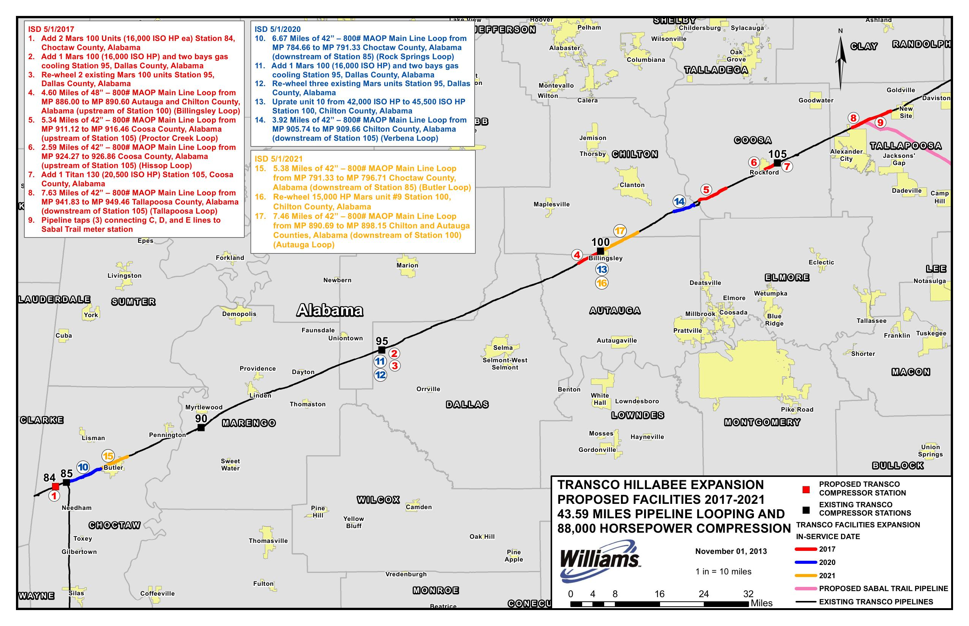
Hillabee Expansion Project

Slide 8
Hillabee Expansion Project
FERC Docket PF14-06 pre-filed 2013-11-04
Expands existing Williams Transco pipeline
Compressor station Choctaw County
43.59 miles additional pipe, etc.
Connect to Sabal Trail, Alexander City, AL
Expects formal FERC filing late Nov 2014
http://spectrabusters.org/2014/10/18/transco-plans-ferc-filing-in-the-next-month-or-so/

Slide 9
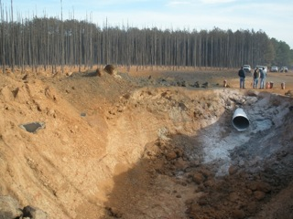
Transco Explosion Marengo Co. AL

Slide 10
Transco Damage Marengo Co. AL
3 Dec 2011, Highway 69 toward Myrtlewood
Flames 100 feet up, heard > 30 miles away
50-foot crater, incinerated 65 acres of trees
Fried five acres of soil into pottery
Launched 43-foot pipe section missile 190 feet
Cause: corrosion
http://spectrabusters.org/2014/01/26/a-36-inch-pipeline-blews-up-in-alabama/

Slide 11
Williams Co. Hazards
2014-04-23: Williams explosion and fire, Opal, WY
2014-04-05: Williams Oak Grove explosion, Marshall County, WV
2014-03-31: Williams fire and explosion near Plymouth, WA
2014-01-10: 3-month Williams methane leak, Suavie Island, OR
2012-10-26: PHMSA Final Order, $74,300 civil penalty: Transco
2012-09-25: PHMSA Corrective Action Order
2011-12-03: Williams Transco, Marengo County, AL
2008-11-14: Williams Transco explosion in Appomattox, VA
http://spectrabusters.org/hazards/other-hazards/#Williams

Slide 12
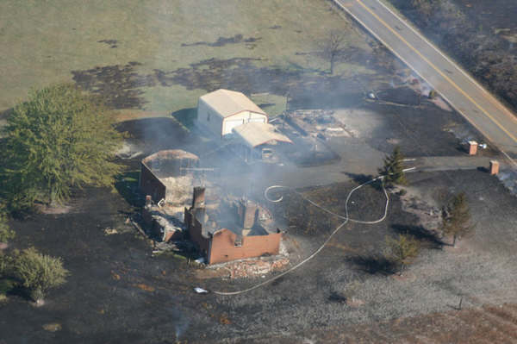
Williams Co. Appomatox, VA 2008-11-14

Slide 13
Williams Appomattox Damage
Large ﬁreball, 37-foot wide, 15-foot deep crater
Burn zone approximately 1125 feet in diameter
Destroyed 2 homes, injured 5 people
Local and state governments footing the bill
PHMSA $952,500 fine for possible failures to
“address regulatory requirements for monitoring and preventing external corrosion”
http://pstrust.org/about-pipelines1/map-of-major-incidents/transco-virgina-accident

Slide 14
Williams Co. Violations
Pipeline & Hazardous Materials Safety Administration
2012-10-26: PHMSA Final Order $74,300 civil penalty to Transco:
“The Notice alleged that Respondent violated 49 C.F.R. §193.2801 by failing to provide and maintain fire protection at its LNG facility at Carlstadt, New Jersey (Facility),…”
“The Notice alleged that Respondent violated 49 C.F.R. §193.2365(d) by failing to inspect each component protected from atmospheric corrosion at intervals not exceeding 3 years…”
2012-09-25: PHMSA Corrective Action Order:
“…to take necessary corrective action to protect the public, property, and the environment from potential hazards associated with a failure involving the Williams Transco Pipe Line (TPL) interstate natural gas pipeline system.”

Slide 15
Yet 3 years later, Marengo Co. AL
2012-02-21: Jason Cannon, Demopolis Times, Corrosion cited in pipeline explosion,
“Although we have systems and processes in place to prevent and identify corrosion, our investigation indicated there were multiple factors working in conjunction that led to this problem not being recognized,” said Transco spokesman Chris Stockton. “Extremely corrosive soil conditions, combined with failures in the pipeline’s protective coating and cathodic protection system ultimately weakened the pipe, causing it to rupture.”
Acidic soil throughout southeast coastal plain,
Especially in blackwater rivers

Slide 16
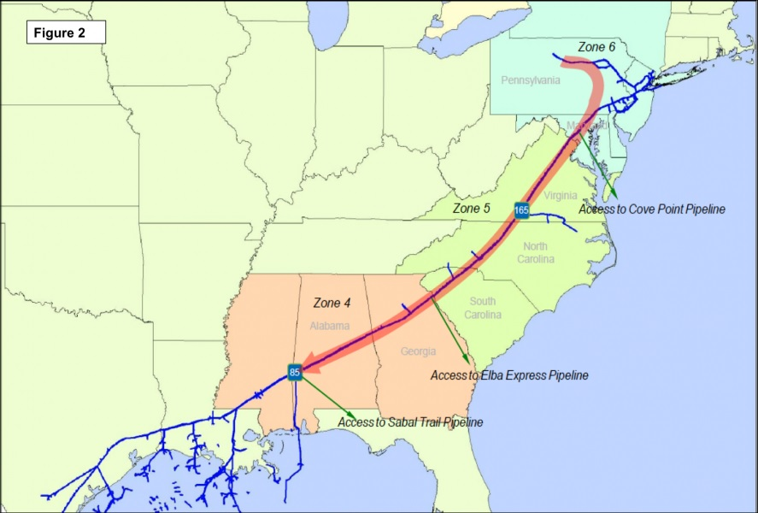
Williams Atlantic Sunrise Pipeline

Slide 17
Same Transco Spokesman: Hillabee and Atlantic Sunrise
Atlantic Sunrise: collect fracked methane from Marcellus Shale in Pennsylvania
Transco: transmit to FERC-approved Cove Point LNG in Maryland, Docket No. CP13-113-000, 2014-09-29
To FERC-applying Elba Island LNG export in Georgia, Docket CP14-103 2014-03-10
To Sabal Trail towards 3 LNG export operations in Florida authorized by Office of Fossil Energy
http://spectrabusters.org/2014/10/18/transco-plans-ferc-filing-in-the-next-month-or-so/

Slide 18
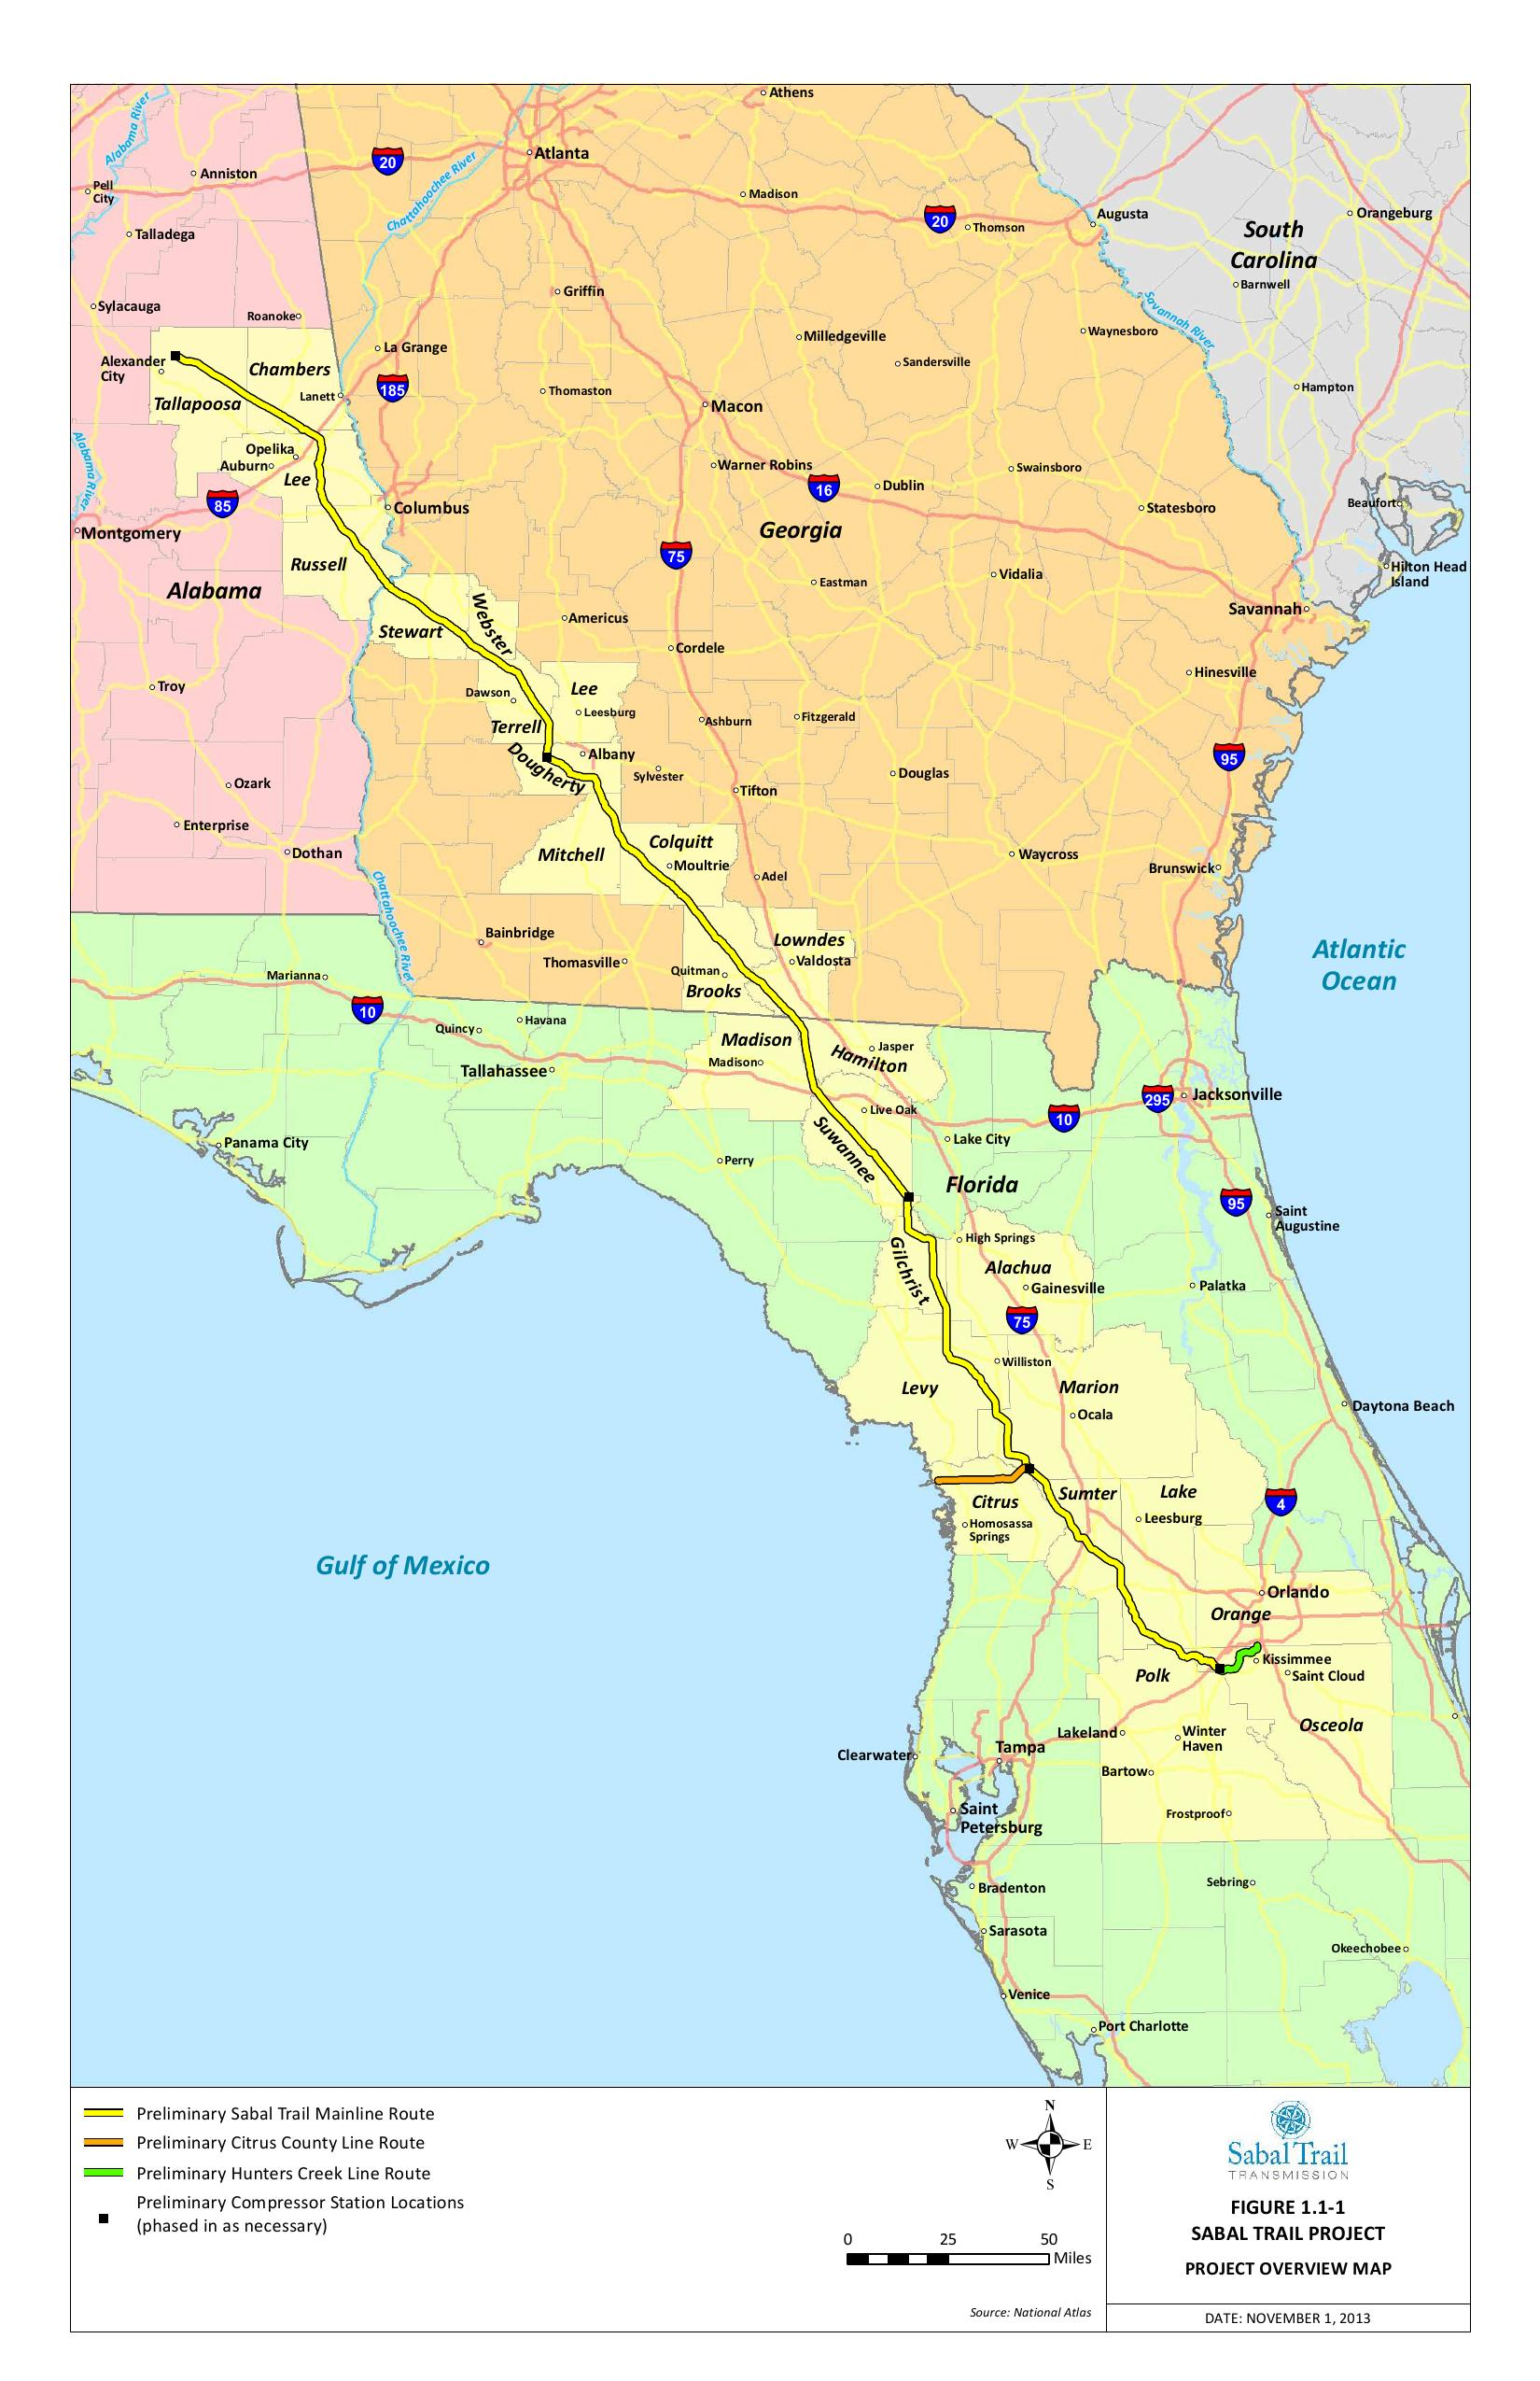
Sabal Trail Transmission

Slide 19
Sabal Trail Transmission LLC
Pre-filed with FERC 2013-10-04 as PF14-01
Joint venture:
pipeline company Spectra Energy, Houston, TX
NextEra Energy
parent of utility FPL, Juno Beach, FL
Managed by Sabal Trail Management LLC
100% owned by Spectra Energy

Slide 20
Spectra Energy safety record
2013-12-31: “The most terrifying experience”: Spectra blows Searsmont, Maine compressor station
2013-12-21: PHMSA Final Order to Spectra CEO Greg Ebel for 5 violations of federal regulations and Spectra’s own company procedures.
1994-03-25: Spectra’s Durham Woods apartment fire, Edison, NJ, 1994: thousands evacuated, hundreds made homeless, massive property damage.
1991-05-15: Pennsylvania fined Spectra $18.6 million + $200 million PCB cleanup
1989-10-21: EPA fined Spectra Energy $15 million for 89 pipeline site PCB spills
1986-02-21: 30-inch pipeline, Lancaster, Kentucky, NTSB report:
“ripped 480 feet of pipe out of the ground, exposed 40 feet of an adjacent parallel pipeline, ignited and destroyed two houses, one house trailer, six automobiles, and damaged other buildings. Three persons were injured, 2 of them seriously, and 77 other persons were evacuated from the area.”
1985-04-27: 700×500 feet incinerated, 5 dead, 3 burned, Beaumont, KY
http://spectrabusters.org/hazards/spectra-safety-violations/

Slide 21
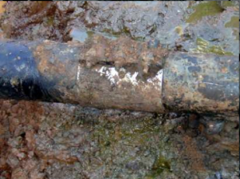
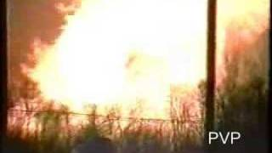
Spectra Energy insurance
Spectra Energy SEC Form 10-K:
“We do not maintain insurance coverage against all of these risks and losses, and any insurance coverage we might maintain may not fully cover the damages caused by those risks and losses.”

Slide 22
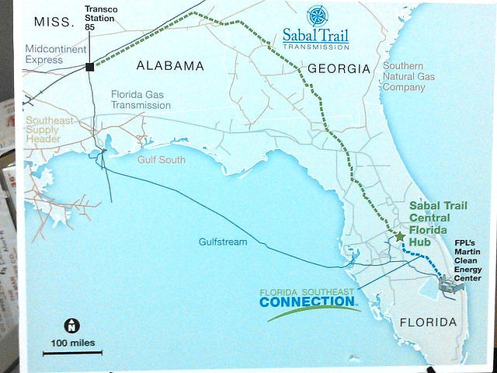
Transco → Sabal Trail → FSC

Slide 23
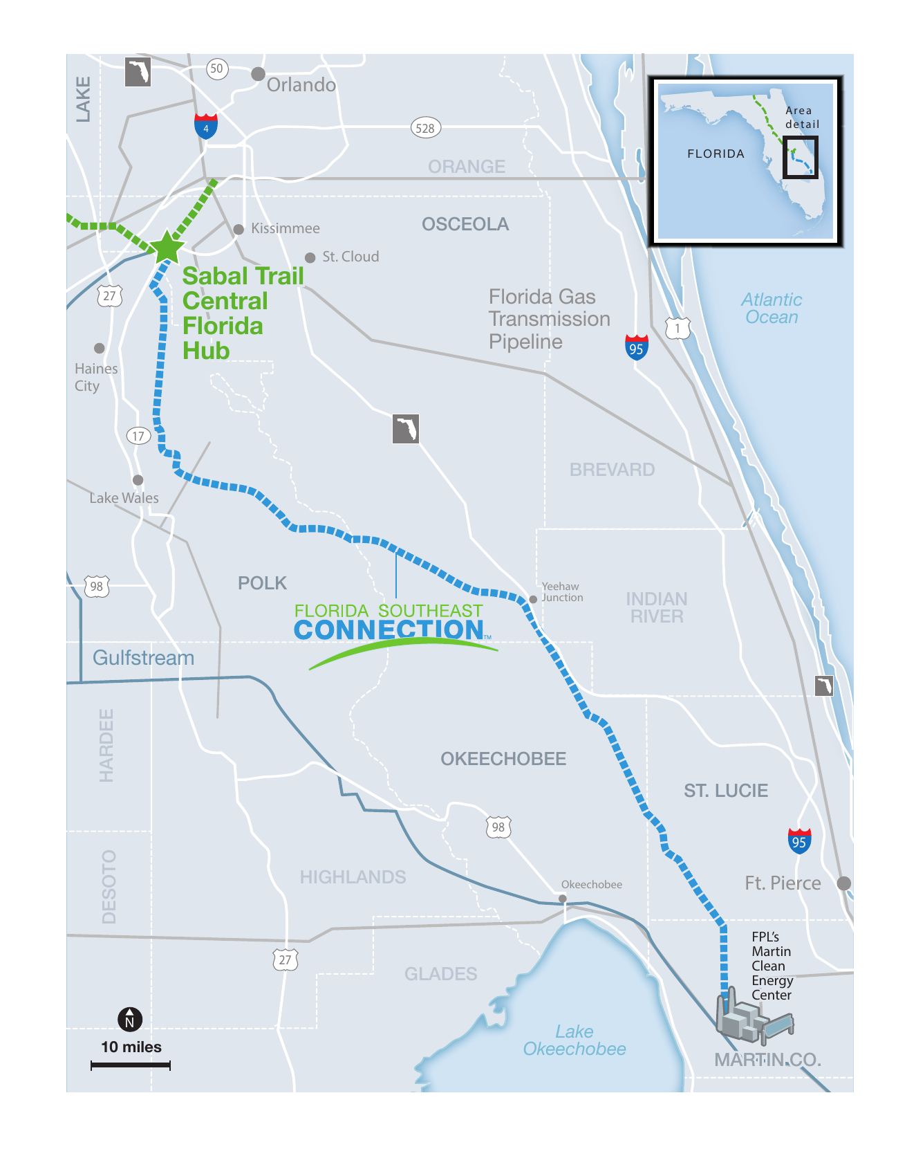
Florida Southeast Connection (FSC)

Slide 24
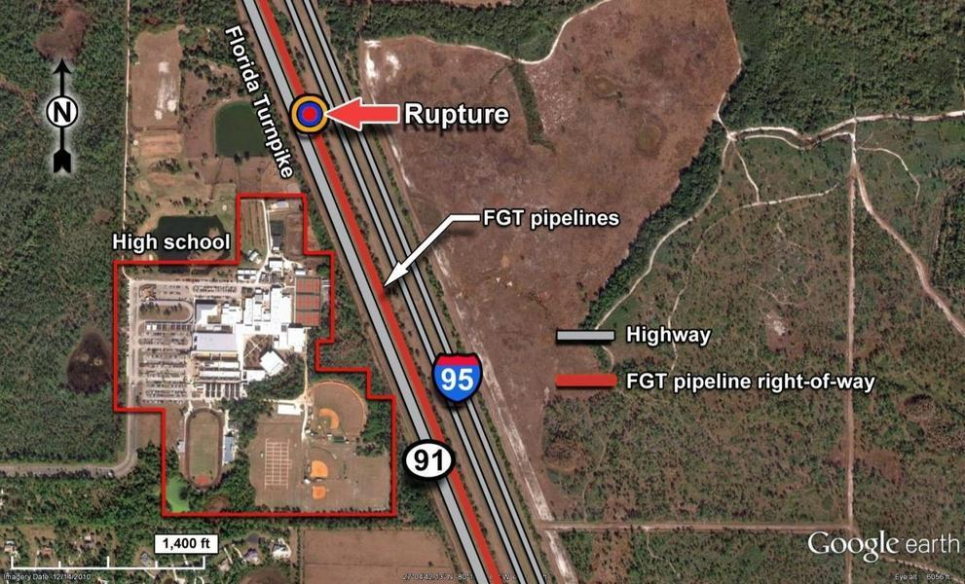
Speaking of Martin County

Slide 25
Martin County Explosion Damage
2009-05-04: Florida Gas Transmission 18-inch pipeline blew up
Between I-95 and Florida Turnpike, shutting down both highways
Flying a 104-foot piece of 18-inch pipe
Missing a nearby high school
NTSB said it was the fault of pipeline operator FGT
Damage/Clean-up Cost: $606,360
Apparently paid by taxpayers
http://spectrabusters.org/2014/02/11/methane-pipeline-blew-up-onto-florida-turnpike-next-to-high-school/

Slide 26
FSC FERC filings
2013-10-04: pre-filed Docket PF14-6
2014-09-26: formal Docket CP14-554-000
2014-10-10: Two weeks later FERC got around to telling everyone about CP14-554-000
Now: time to file as intervenor on FSC docket
http://spectrabusters.org/2014/10/10/fsc-formally-filed-for-ferc-permit-26-september-2014/

Slide 27
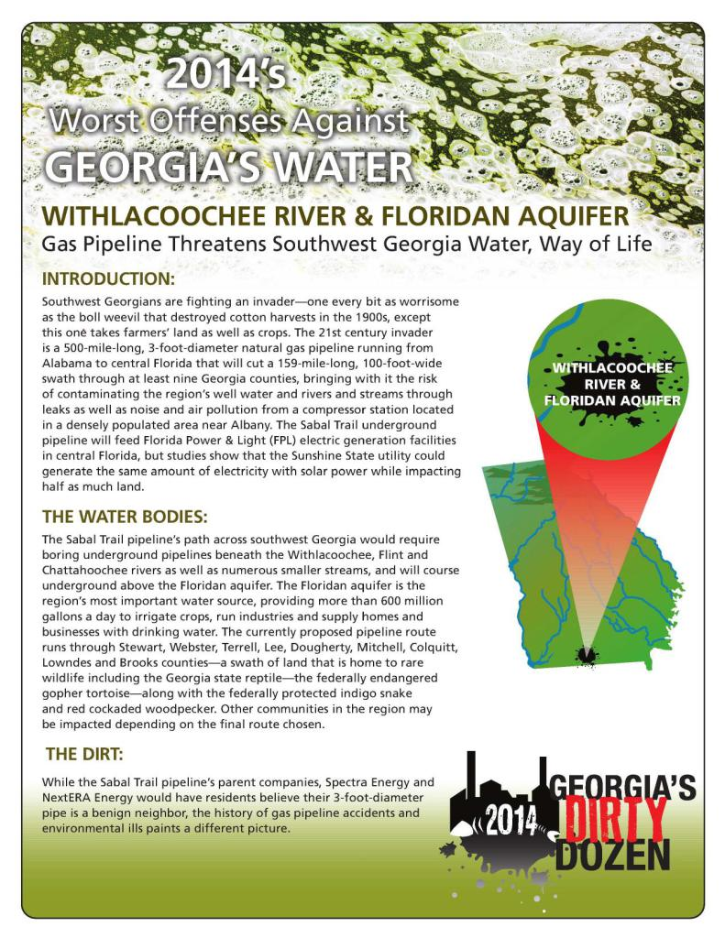
Georgia Water Coalition Dirty Dozen
2014-10-22: 2014’s
Worst Offenses Against
GEORGIA’S WATER
WITHLACOOCHEE RIVER
& FLORIDAN AQUIFER:
Gas Pipeline Threatens
Southwest Georgia Water,
Way of Life

Slide 28
Georgia Water Coalition Dirty Dozen
#9: Sabal Trail pipeline threatens Withlacoochee River and Floridan Aquifer
“Southwest Georgians are fighting an invader—one every bit as worrisome as the boll weevil that destroyed cotton harvests in the 1900s, except this one takes farmers’ land as well as crops.”
“bringing with it the risk of contaminating the region’s well water and rivers and streams through leaks as well as noise and air pollution from a compressor station located in a densely populated area near Albany.”
http://www.wwals.net/2014/10/22/gwc-dd9-sabal-trail-pipeline-threatens-withlacoochee-river-floridan-aquifer/

Slide 29
DD #9 Rivers
Georgia: Withlacoochee, Flint, and Chattahoochee Rivers
Alabama: Coosa, Tallapoosa, Cahaba, Black Warrior, and Tombigbee Rivers
Florida: Withlacoochee North (again!), Suwannee, Santa Fe, and Withlacoochee (central Florida)
Georgia and Florida: Floridan Aquifer
http://www.wwals.net/2014/10/22/gwc-dd9-sabal-trail-pipeline-threatens-withlacoochee-river-floridan-aquifer/

Slide 30
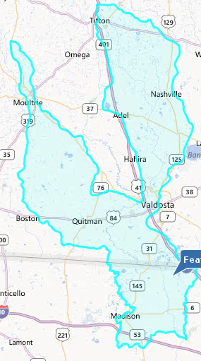

WWALS Watershed Coalition
WWALS proposed DD #9

Slide 31
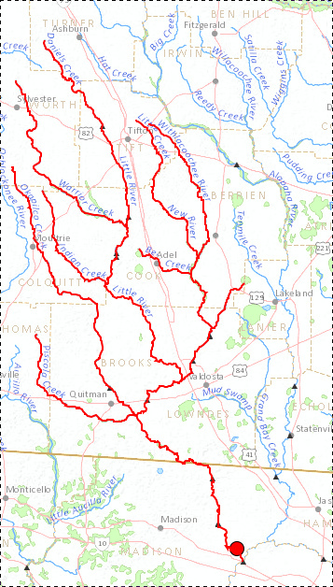
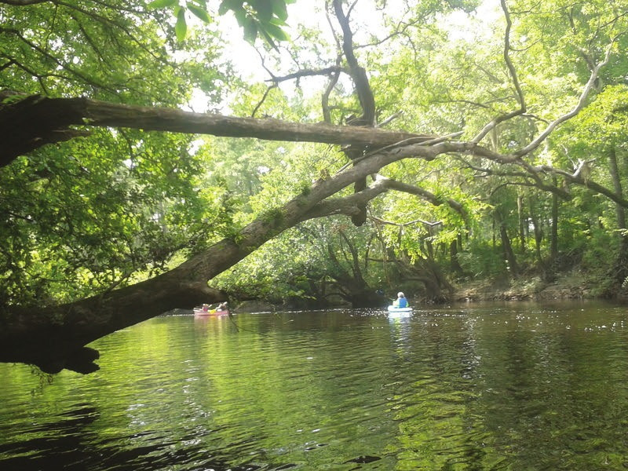
Withlacoochee River

Slide 32
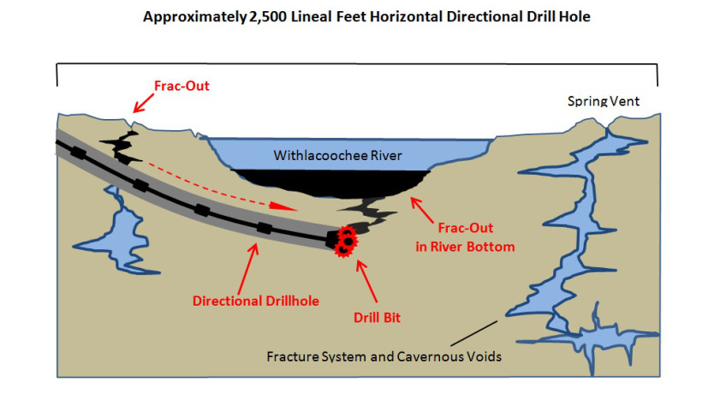
Potential sinkhole or collapse
feature forming as a result of the proposed HDD crossing of the Withlacoochee River
David Brown, hydrogeology report, August 2014, for Chris Mericle.

Slide 33
Hamilton County, FL Resolution
2014-08-19: RESOLUTION NO. 14- I0 7
“recommends that the pipeline route be reconsidered to avoid sensitive karst regions that can have a signiﬁcant impact on the water resources in the area of that location”

Slide 34
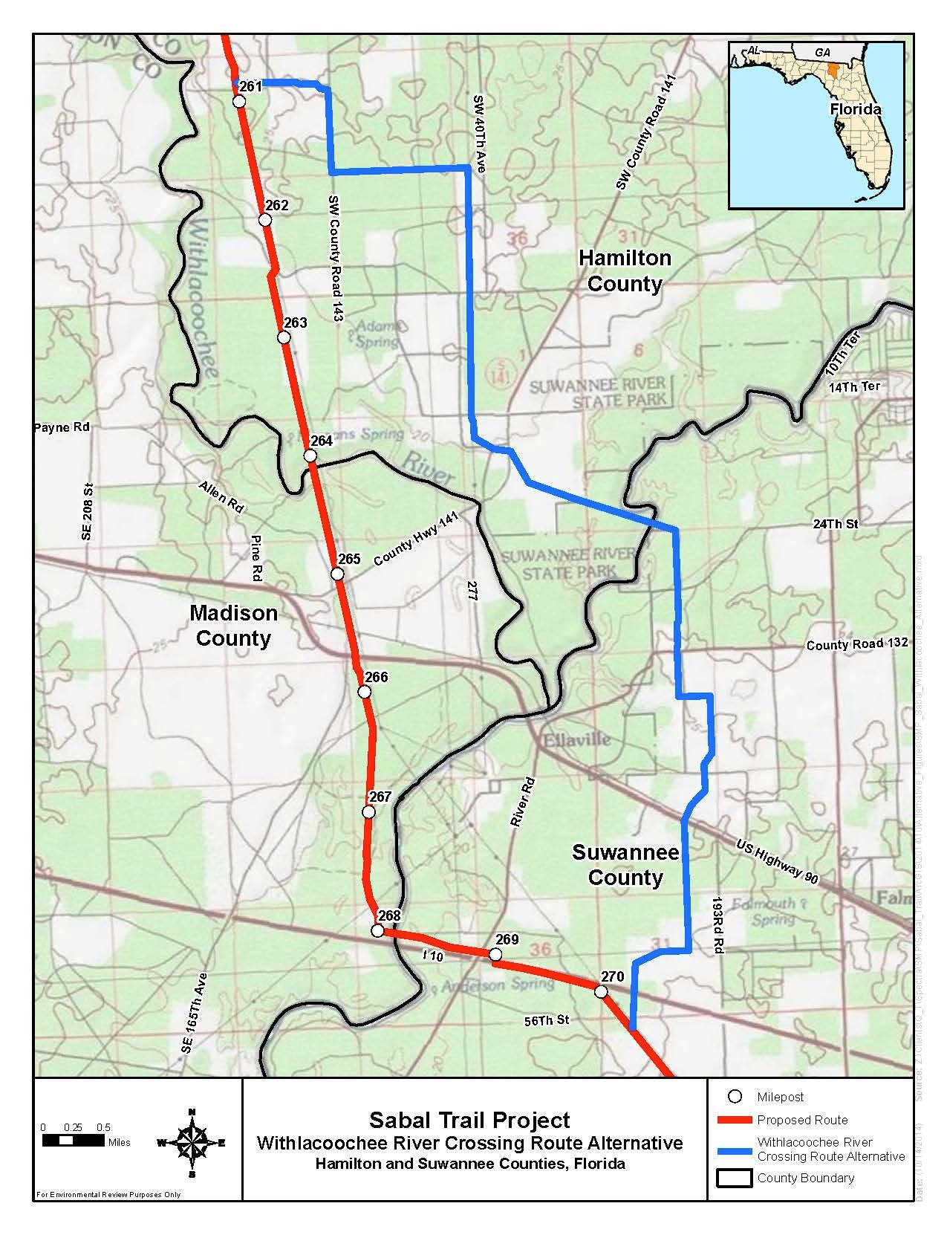
Withlacoochee Alternative
2014-10-15: FERC announced
2014-11-15: end Comment period
2014-10-31: Sabal Trail target date for formal filing blown

Slide 35
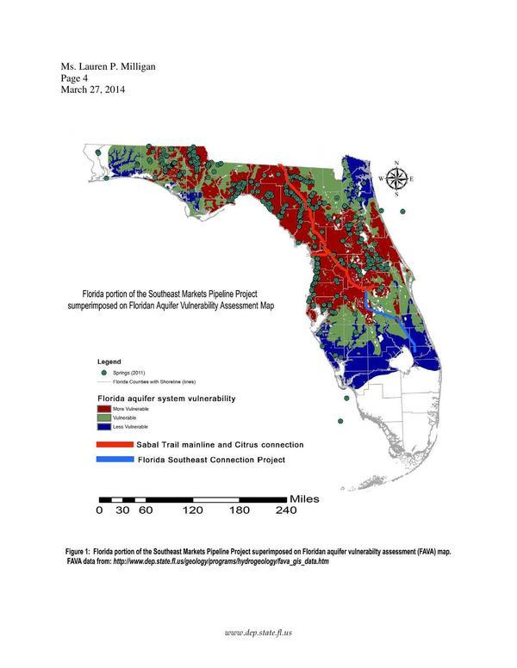
Pipeline and Aquifer Vulnerability
2014-03-27: FL-DEP to FERC
Basically, there is no safe place for Sabal Trail in north Florida
(and south Georgia same geology)

Slide 36
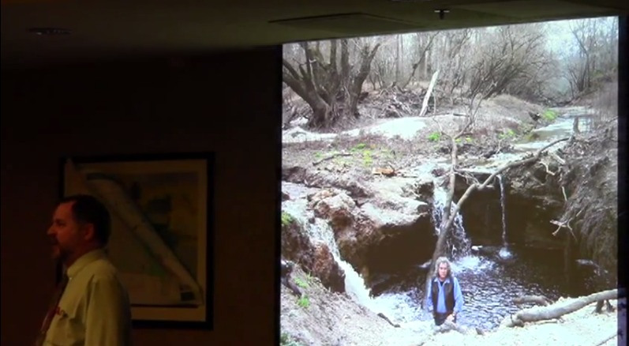
Withlacoochee River already leaks into a sinkhole, with more forming (Dr. Don Thieme of VSU to WWALS)

Slide 37
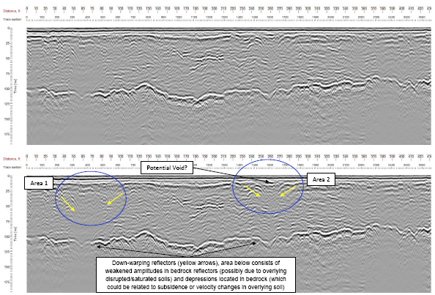
GPR of Cherry Creek Sink towards Withlacoochee River

Slide 38
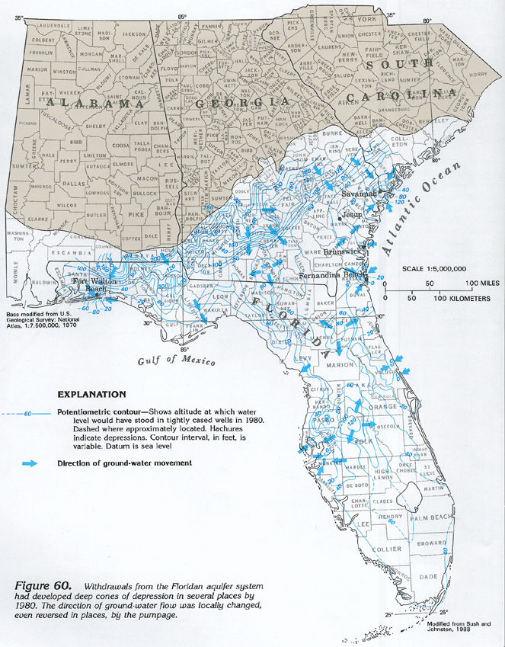
Floridan Aquifer
Drinking water source for south Georgia and all of Florida
Withlacoochee leak into aquifer:
Why Valdosta's wells are 400 feet deep

Slide 39
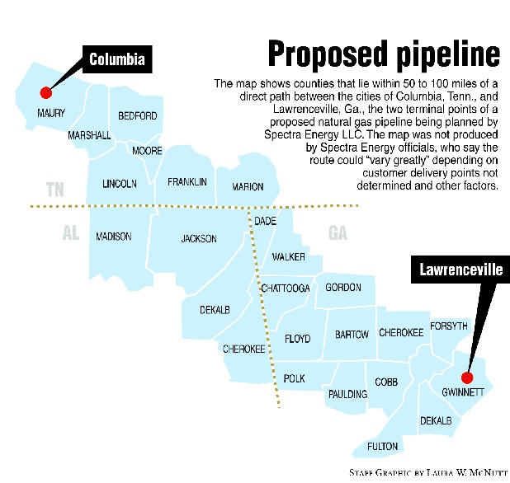
Spectra's Renaissance Pipeline

Slide 40
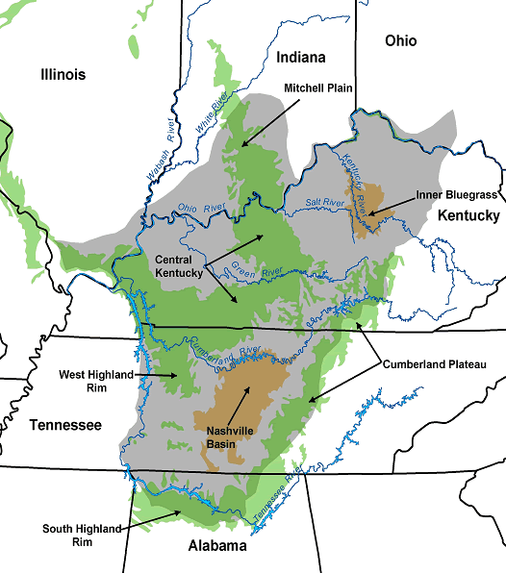
TN-AL karst aquifers (USGS)

Slide 41
FPL's “Need” for more energy
U.S. EPA asked why need when U.S. energy demand continues to decrease
Why not conservation, efficiency, and solar power?
FPL's own FL-PSC 10-year plan projects only 13% increased electricity demand for Florida next decade
How does that justify a third pipeline, or 50% increase in gas?
LED lights in big buildings and smart switches could probably save 13% according to some calculations

Slide 42
Solar Power for the Sunshine State
FPL has added zero new utility-scale solar power in past 3 years (source: FPL's FL-PSC 10-year plan)
Sabal Trail says FPL wants to shut down coal plants and nukes and solar won't cut it as baseload capacity
Yet according to Sabal Trail's own figures, solar PV panels could generate as much electricity on half the acreage of their pipeline

Slide 43
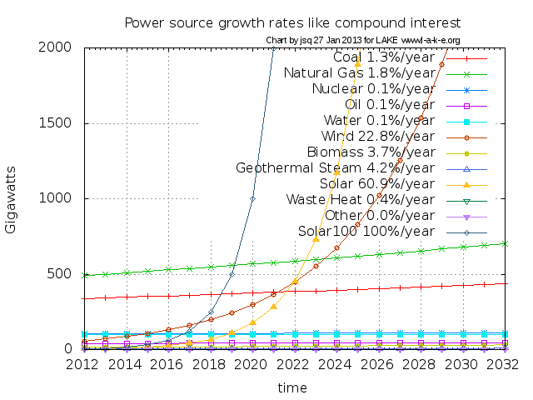
Distributed solar and wind: disruptive challenge to utilities
2013-01: Edison Electric Institute
2013-05-03: Analyst Michael Sankowski
2013-08-21: FERC Chair Jon Wellinghoff
2013-12-22: Liam Denning, “death spiral” for non-renewable utilities
Many more

Slide 44
So why all the proposed pipelines?
Florida doesn't seem to need the power
Conservation, efficiency, and solar are far cheaper, faster, and safer
So why these and many other proposed pipelines?

Slide 45
LNG export from Florida
Three already authorized by Office of Fossil Energy (FE) of U.S. Dept. of Energy:
2011-07-27: Carib Energy, now owned by Crowley Maritime of Jacksonville, FL
Before Sabal Trail pre-filed with FERC, yet FERC never mentioned it when asked about LNG export
2013-11-14: Floridian LNG (FliNG)
before Sabal Trail Open Houses or FERC Scoping Meetings
2013-12-12: Goven
http://spectrabusters.org/lng-export/#Florida

Slide 46
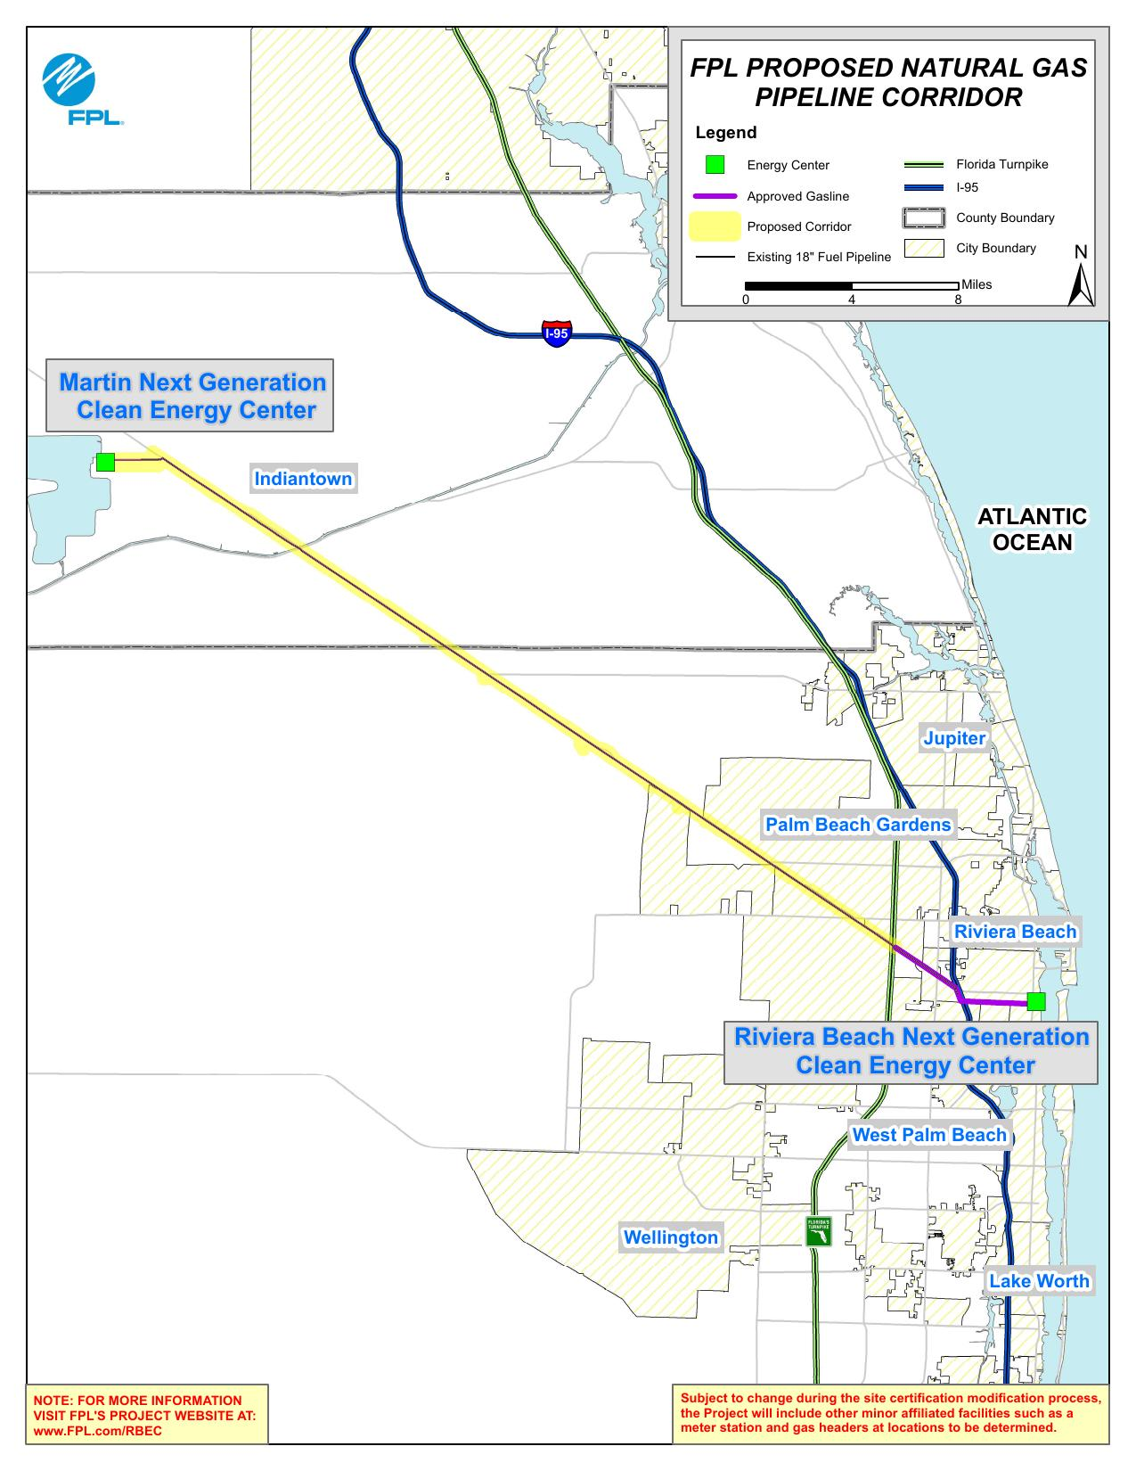
FPL pipeline: Martin Co. to Atlantic Coast of Florida (not part of FSM: no FERC docket)

Slide 47
Another LNG export filing
Strom, Inc.:
2014-03-27: FERC Docket CP14-121 for containerized LNG export from Starke, FL using Sabal Trail methane
2014-08-22: FERC dismissed Strom application for lack of fee payment (more about FERC fees later)
2014-09-25: Strom asked FE to move location to Crystal River, FL, to get methane from either FGT or Sabal Trail
http://spectrabusters.org/lng-export/#Strom

Slide 48
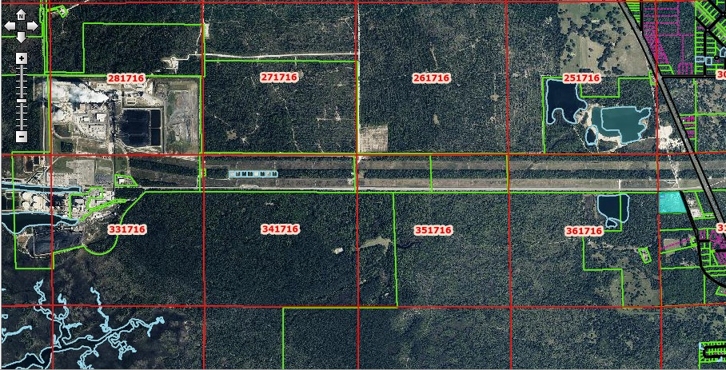
Strom same road as Duke Crystal River plant

Slide 49
TECO pipeline to Jaxport?
2014-03-10: Jacksonville Business Journal, TECO Peoples Gas looks to expand natural gas pipeline to Jacksonville
“The company see the need to provide more gas supplies to Northeast Florida, with increased use of natural gas to generate electricity and use of liquified natural gas at the port. The Jacksonville Electric Authority and one cargo shipper wants to build liquified natural gas plants near the port.”

Slide 50
LNG export from Florida
There's more, including
Dolphin LNG import proposal could refile for export
An undersea pipeline proposal to the Bahamas could refile for export
But the basics are three already-authorized by FE LNG export operations in Florida

Slide 51
Why LNG export?
2013-05-15: T. Boone Pickens,
“The producers have gone out and drilled for the natural gas. They should be entitled to get the best markets in the world, so let them have it.”
2013-12-05: Tony Clark, FERC Commisioner, testimony to Congress,
“The large amount of natural gas in the U.S. is also creating an impetus for something that was nearly unimaginable ten or fifteen year ago, LNG export”
2014-03-25: Paula Gant, head, Office of Fossil Energy, testimony to Congress,
“Today, domestic natural gas prices are lower than international prices of delivered LNG to overseas markets. ...demand for natural gas is growing rapidly in foreign markets. Due primarily to these developments, DOE has received a growing number of applications to export domestically produced natural gas to overseas markets in the form of LNG.”
http://spectrabusters.org/lng-export/

Slide 52
Trans-Pacific Partnership (TPP)
2013-08-01: Ted Poe, Chair, SUBCOMMITTEE ON TERRORISM, NONPROLIFERATION, AND TRADE of the COMMITTEE ON FOREIGN AFFAIRS, HOUSE OF REPRESENTATIVES,
“Hopefully, we will change that and become an exporter, especially of natural gas.”
“Right now, we are in the middle of negotiating a new agreement, the Trans-Pacific Partnership or the TPP, as an opportunity for the United States to expand its trade network in the Asia-Pacific region and beyond. TPP will open trade between the United States and 11 other countries. This would make it America’s largest free trade agreement.”

Slide 53
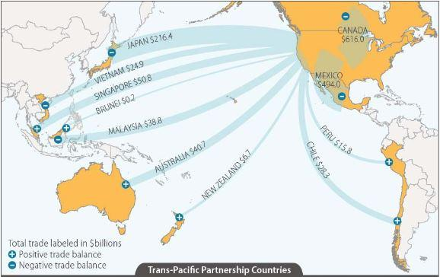
Trans-Pacific Partnership (TPP)

Slide 54
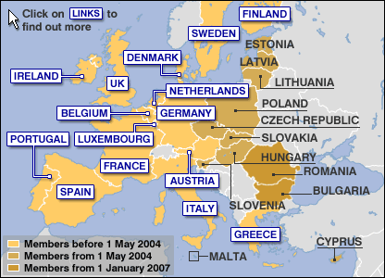
Transatlantic Trade and Investment Partnership (TTIP) aka Transatlantic Free Trade Area (TAFTA)

Slide 55
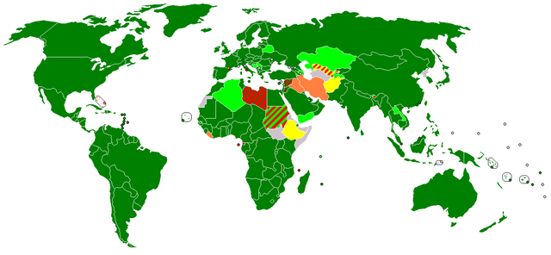
H.R. 6, passed by U.S. House
Would legalize LNG exports to all 159 WTO member countries, including China and Ukraine

Slide 56
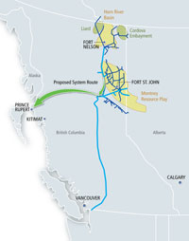
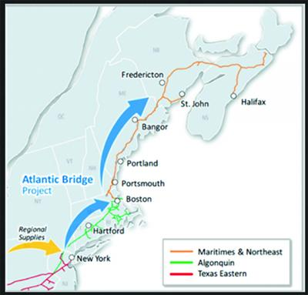
Spectra BC export pipeline and Maritimes connection

Slide 57
LNG export summary
There's more (Oregon, Louisiana, Cove Point, Maryland, Elba Island, Georgia, etc.)
But probably you can see the fossil fuel industry has fracked a glut of gas and feels “entitled” to build pipelines to export it to get five times the price overseas
Pretty much everywhere overseas if TPP and TAFTA or just H.R. 6 passes
And with 3 already-authorized LNG export operations where Transco → Sabal Trail → FSC goes....

Slide 58
What can be Done
Ecomment to FERC and file as intervenor: Www.ferc.gov
Contact local, state, and national elected and appointed officials: lots of non-FERC permits
Sue and other legal action; call sheriff on trespassers
Pass resolutions and ordinances: even FERC says they pay attention to those, and evidence says they do
Protest with signs
Write letters to the editor and op-eds
Call talk radio and get on as a guest
Get interviewed by radio, TV, newspapers

Slide 59
Ecomment to FERC
2014-04-07: Greenlaw objected to FERC on behalf of Chattahoochee Riverkeeper, Flint Riverkeeper, and landowners in Dougherty County, GA
Many individuals and groups have done so
FERC has told Sabal Trail to produce route alternatives and to study karst and other topics
Anybody signed up for the docket with FERC sees everybody else's ecomments

Slide 60
Don't depend on FERC alone
FERC has only denied 2 pipelines in recent decades, according to FERC
FERC is 100% funded by fees from the same industries it regulates, according to FERC
FERC permitted Cove Point LNG in Maryland the same day massive opposition attended a meeting in Albany, GA with FERC and Sabal Trail and FERC didn't say a word about it there.

Slide 61
Greenlaw and Ted Turner object to Sabal Trail air permit request
Sabal Trail applied to GA-EPD for air permit for Albany, GA compressor station
2014-07: Greenlaw filed objections
2014-07-11: Ted Turner's Nonami Plantation is near the proposed pipeline route: they filed objections

Slide 62
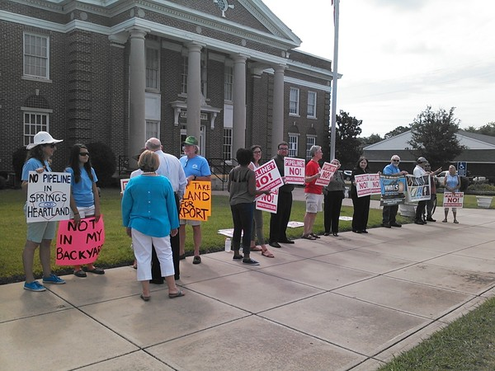
Landowners countersued Sabal Trail for trespass, in Leesburg, GA

Slide 63
Leesburg, GA results
Sabal Trail didn't get GA eminent domain ruling
They did get bound to return to south GA for a criminal trespass trial
Protesters came from as far as 9 hours away
News coverage: WALB-TV, op-eds by WWALS, Our Santa Fe River, and others
Sabal Trail lost the later trespass trial

Slide 64
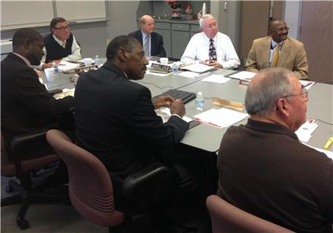
Pass Resolutions
2014-10: Albany and Dougherty County, Georgia

Slide 65
Pass Resolutions
2014-10-27: Dougherty County passed a resolution against the Sabal Trail pipeline
2014-10-29: Albany City Commission joins Dougherty County Commission in opposing Sabal pipeline
Resolution notes proposed proximity of the propsed pipeline to wells, airport, city schools

Slide 66
Resolutions can have effects
Hamilton County, FL resolution helped get Sabal Trail off Withlacoochee River in Florida
(Lowndes County, GA passed nothing, and Sabal Trail has made no move off the Withlacoochee in Georgia)
Multiple resolutions in Virginia against a proposed pipeline
Soon afterwards Spectra backed out of even bidding on that pipeline

Slide 67
Resolutions can have effects
Hamilton County, FL resolution helped get Sabal Trail off Withlacoochee River in Florida
(Lowndes County, GA passed nothing, and Sabal Trail has made no move off the Withlacoochee in Georgia)
Multiple resolutions in Virginia against a proposed pipeline
Soon afterwards Spectra backed out of even bidding on that pipeline

Slide 68
Pass Ordinances
Carefully-crafted ordinances such as for land-use or noise based in the local Comprehensive Plan are laws with legal teeth
Jefferson County, FL passed a land-use ordinance to keep bottling plants out of the Floridan Aquifer
Even FERC says they try whenever possible not to override local ordinances
And PA and NY Supreme Court decisions indicate maybe FERC can't even do that

Slide 69
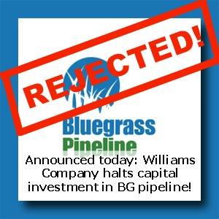
Inform the public and raise opposition

Slide 70
Opposition can cancel pipelines
Bluegrass pipeline from Ohio through Kentucky
Massive public opposition
a judge ruled against state eminent domain
2014-04-29: Williams Co. indefinitely suspended it, claiming
“an insufficient level of firm customer commitment”
Investors don't like public opposition; see Spectra's SEC Form 10-K

Slide 71
Spectra campaign scandals
FL Gov. Rick Scott owned Spectra stock before FL-PSC approved Sabal Trail pipeline
Spectra Energy Pac donated $10,000 each to re-election campaigns of:
GA Gov. Nathan Deal
AL Gov. Robert Bentley
TN Gov. Bill Haslam
Deal and Bentley accepted a lot more from more pipeline and energy companies
GA candidate for Gov. Jason Carter did not

Slide 72
Many allies across the continent and beyond
Here is a list of some allies:
http://spectrabusters.org/allies/
There are far more:
Fracking, pipelines, and LNG export produce opposition everywhere
October 2014: continuous bad PR for pipelines
And excellent PR for conservation and renewables
Keep working for conservation & clean energy

Slide 73
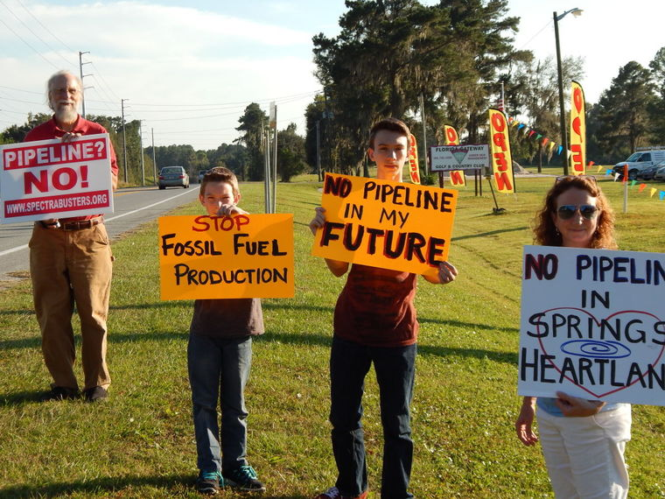
See you at the protest!
John S. Quarterman,229-242-0102
river@quarterman.org

